Slide 1
APPENDIX M
Child
and
Adolescent
Trauma
Screen
“CATS” “”

Slide 2
DSM-5 based checklist
15 potentially traumatic events or series of events
20 posttraumatic stress symptoms (PTSS)
5 impairment items
self-report measure for 7–17-year-old children/youth
caregiver for 7–17-year-old children/youth
can be interview or self-report
“IMPORTANT: The measure can further be implemented as routine symptom monitoring during treatment”.
You will be facilitating a self-report

Slide 3
15 potentially traumatic events or series of events
The child or caretaker will simply check yes or no.
This happened to me at anytime or it didn’t
You will be facilitating a self-report

Slide 4
20 posttraumatic stress symptoms (PTSS)
The child or caretaker has four options
I experience these symptoms:
Never
Once in a while
Half the time
Almost always
You will be facilitating a self-report

Slide 5
5 impairment items
The things that happened to me/ the symptoms I experience
get in the way of these activities
Yes or No
You will be facilitating a self-report

Slide 6
School

Slide 7
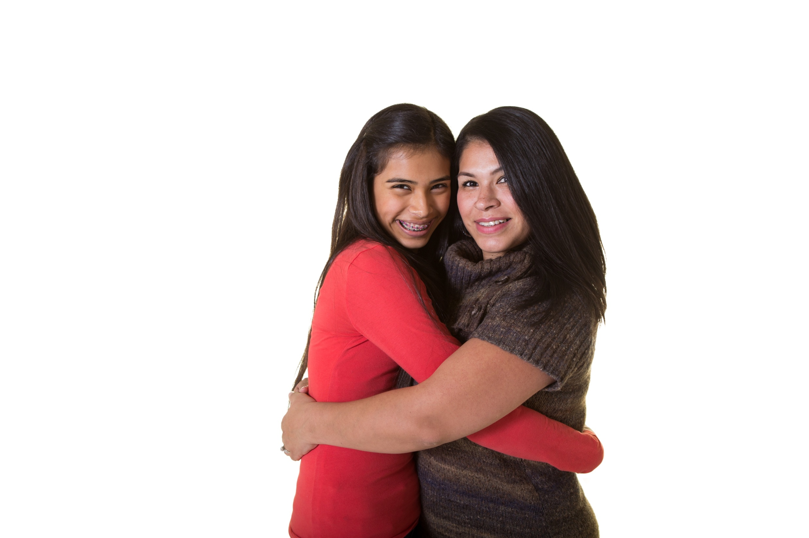
Children will take their self-assessments at appointed times during the school day
3 X during the semester.
Parents will e take their self-assessments at appointed times separately from children.

Slide 8
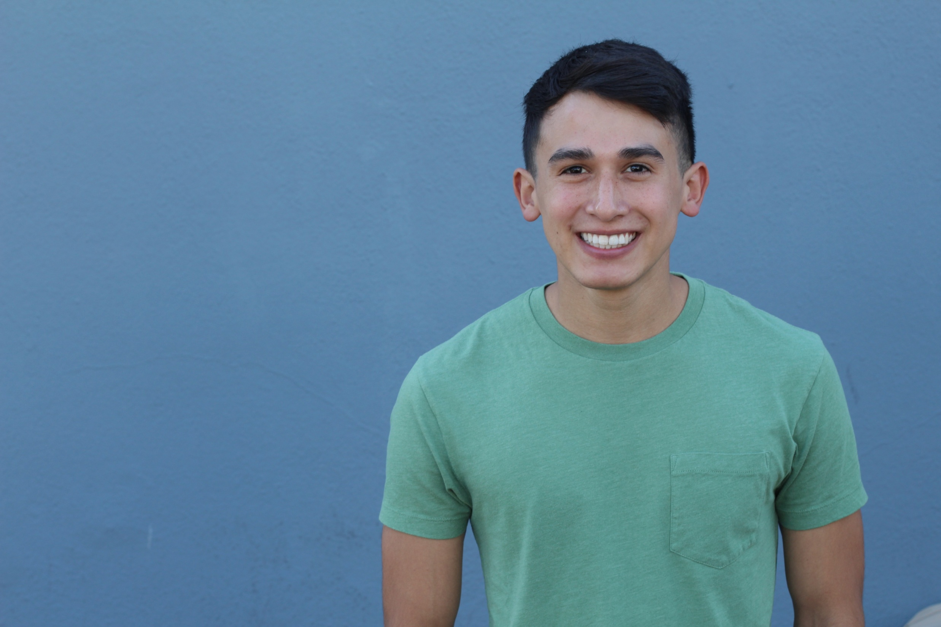
Make some small talk.
Assure child or (caretaker) of confidentiality (and limits). Only a
number- no name on the question form.
Let them know you will not see questions and answers
Only the statistician will see answers to the questions, but he will not know your name. No one else will see your questions or answers.

Slide 9
Demonstrate how to use the iPad
and to answer assessment questions
Inform child (or Caretaker) they
can ask questions or talk about
their answers if they want to but it
is not necessary or part of the
assessment
Tell them that if they do want to talk
it will be confidential except if they are
or others are in immediate danger

Slide 10
Always reassure and normalizes as much as you can if they do talk
Never judge anyone involved in a story
Thank child (or caretaker) for cooperating
Compliment them
on their strong points

Slide 11
Don’t act surprised
or shocked
Stay calm
But
caring

Slide 12
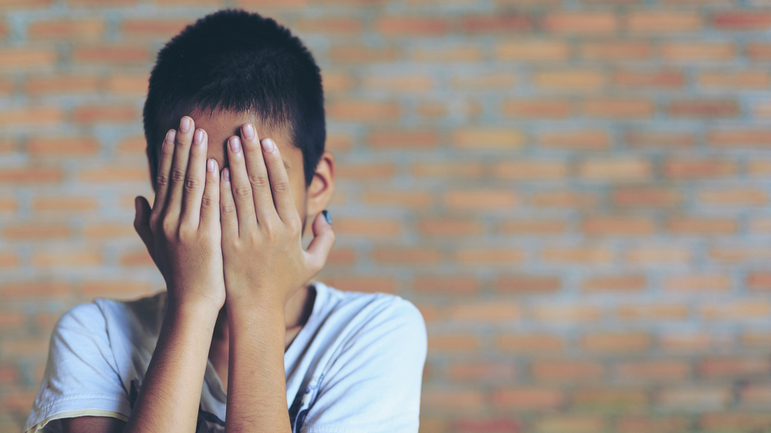
Report to teacher if you feel there is imminent danger to self or others

